Slide 1
Modern Systems Analysis
and Design
Eighth Edition, Global Edition
Joseph S. Valacich
Joey F. George
Chapter 2
The Origins of Software

Slide 2
Learning Objectives
Explain outsourcing.
Describe six different sources of software.
Discuss how to evaluate off-the-shelf software.
Explain reuse and its role in software development.

Slide 3
Introduction
Historically, software development for a corporate information systems department was done primarily in-house.
Now it involves use of components from external sources.
Much in-house application coding involves making the components work together.

Slide 4
Introduction (cont.)
Six sources of software:
  Information technology service firms
  Packaged software providers
  Vendors of enterprise-wide solution software
  Cloud computing
  Open-source software
  In-house development
There are ways to evaluate software from sources
Notes:
When choosing a software solution, you’ll be choosing among a number of possible types of software solutions, and for each type, there are a variety of different products and vendors to choose between. For the next several slides we’ll talk about the different possibilities and how to choose among them.

Slide 5
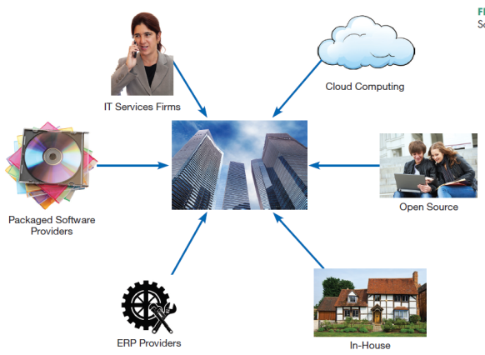
Sources of Software
Information technology services firm
Packaged software producers
Enterprise solutions software
  Enterprise Resource Planning (ERP)
Cloud computing
Open source software
In-house developers
There are ways to evaluate software from sources
FIGURE 2-1
Sources of Application Software
Notes:
A company may use any combination of these sources for their information system.
When choosing a software solution, you’ll be choosing among a number of possible types of software solutions, and for each type, there are a variety of different products and vendors to choose between. For the next several slides we’ll talk about the different possibilities and how to choose among them.
We’ll talk about each of these in more detail.

Slide 6
Systems Acquisition: Outsourcing
Outsourcing: The practice of turning over responsibility of some or all of an organization’s information systems applications and operations to an outside firm
Notes:
Chances are, your company outsources at least part of its overall corporate information system.

Slide 7
Systems Acquisition: Outsourcing (Cont.)
Outsourcing Example
  Shell Oil outsource spending: $3.2 billion (2008)
  Shell’s outsourcing vendors (2008-2011): EDS, T-Systems, AT&T, IBM, Logica, Wipro, Accenture
Notes:
For a very large operation, there may be many outsourced companies working on the project. Big corporations are one example. The U.S. government is another.

Slide 8
Outsourcing (Cont.)
Reasons to outsource
  Cost-effectiveness
  Take advantage of economies of scale
  Make up for lack of in-house knowledge
  Free up internal resources
  Reduce time to market
  Increase process efficiencies
  System development is a non-core activity for the organization
  Political reasons (e.g. labor disputes)
Notes:
These are the main motivators behind the outsourcing phenomenon in the IT economy.

Slide 9
Global Outsourcing
Top outsourcing countries: India, China, Malaysia (A.T. Kearny report 2014)
Top 10 are in Asia, Latin America, Europe, and Africa
Some U.S. firms are switching to nearshoring (same time zone, low labor costs)
Notes:
For a time in the early 2000s there was a concern that our IT would all be outsourced abroad because of lower labor costs. This hasn’t happened, although a good part of IT services provided to US companies are done abroad. Nevertheless, there’s a thriving IT sector in the US as well.

Slide 10
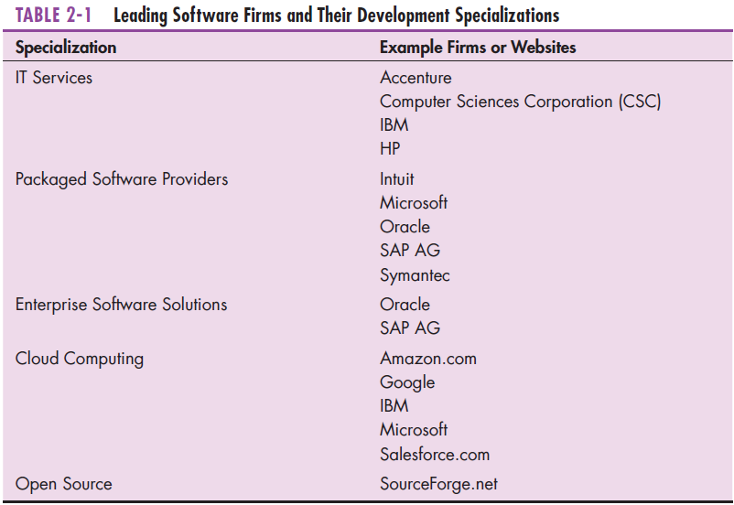
Sources of Software (Cont.)
Notes:
Software produced by IT services firms is usually custom software, for a particular client. Other sectors, like packaged software providers and ERP firms have a particular product suite and help with installing (and sometimes customizing) it at customers’ sites. Open source products are typically free of charge, and governed by General Public License (GNU) license, Cloud computing includes cloud-based storage and computing infrastructure as well as software services and platforms.

Slide 11
Information Technology (IT) Services Firms
Help companies develop custom information systems for internal use
Develop, host, and run applications for customers
Provide other services (management, accounting, auditing, financial)
Notes:
You might think of IBM as primarily a hardware provider, but it’s actually a leader in IT services as well, thanks in part to its purchase of PWC in 2002.

Slide 12
Packaged Software Producers
Serve many market segments
Provide software ranging from broad-based packages (i.e. general ledger) to niche packages (i.e. day care management)
Pre-packaged, off-the-shelf software

Slide 13
Packaged Software Producers (Cont.)
Software runs on all size computers, from microcomputers to large mainframes.
Prepackaged software is off-the-shelf, turnkey software (i.e. not customizable).
Off-the-shelf software, at best, meets 70% of organizations’ needs.
Notes:
Some off-the-shelf software systems cannot be modified to meet the specific, individual needs. These are sometimes called turnkey systems. Turnkey systems are changed only when a substantial number of users ask it. Other systems allow for modification and extension to meet more specialized needs.

Slide 14
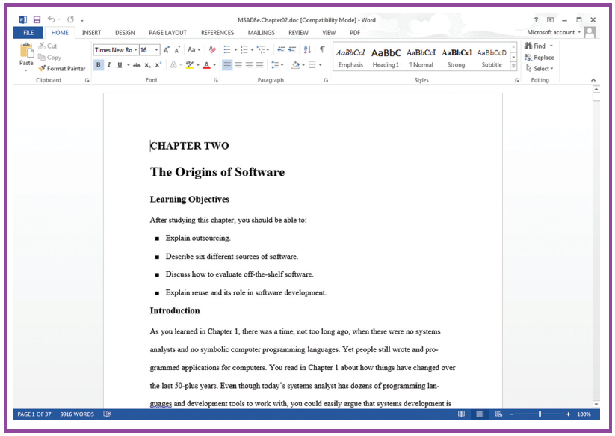
Prepackaged Software
Figure 2-2 A document created in Microsoft’s Word
(Source: Microsoft Corporation.)
Notes:
This is part of the Microsoft Office suite, which includes Excel, PowerPoint, and other applications. This is used by the general public and is sometimes called “horizontal” application. Others prepackaged software products are for more specific audiences, and these are sometimes called “vertical” applications.

Slide 15
Enterprise Solutions Software
Enterprise Resource Planning (ERP) systems integrate individual traditional business functions into modules enabling a single seamless transaction to cut across functional boundaries.
SAP AG is the leading vendor of ERP systems.
Notes:
The benefits of the enterprise solutions approach include a single repository of data for all aspects of a business process and the flexibility of the modules. A single repository ensures more consistent and accurate data, and requires less maintenance. But these are very complex systems with difficult implementations, requiring vendor support. Also, using them often requires a company to alter their business processes.

Slide 16
Enterprise Solutions Software (Cont.)
Figure 2-3 SAP’s Business ByDesign, a product designed for medium sized companies.
(Source: www.sap.com/usa/solutions/Sme/Businessbydesign/Flash/bsm/A1S.html. © Copyright SAP AG. All rights reserved.)
Notes:
SAP is the biggest ERP provider. They are headquartered in Germany.

Slide 17
Cloud Computing
The provision of computing resources, including applications, over the Internet, so customers do not have to invest in the computing infrastructure needed to run and maintain the resources
Pay-per-use or monthly/yearly licenses

Slide 18
Cloud Computing (Cont.)
Examples:
  Google Apps– for sharing documents, spreadsheets, and presentations
  Salesforce.com – online customer relationship management (CRM) software
    An example of software as a service (SaaS)
  Microsoft Azure platform
  Amazon.com cloud infrastructure and services
    An example of hardware as a service (HaaS)
Notes:
Google Apps is a cloud-based competitor to Microsoft Office. Actually, Microsoft has Microsoft 365, which provides cloud-based Word, Excel, and PowerPoint applications. These are for the general user audience. By contrast, Salesforce.com is for a narrower target market (sales and customer relations).

Slide 19
Cloud Computing (Cont.)
Heavy growth predicted
Benefits:
  Frees company of internal IT staff requirements
  Faster access to application than via internal development
  Lower cost than internal development
Concerns
  Security
  Reliability
  Regulation compliance
Notes:
As with every choice, the choice of cloud computing comes with its benefits and concerns.

Slide 20
Open Source Software
Freely available including source code
Developed by a community of interested people
Performs the same functions as commercial software
Examples: Linux, mySQL, Firefox
How to make money?
  Provide maintenance/services
  Sell a more featured version of the free software
Notes:
There are a huge number of open-source projects available. Some other widely-used open source software include the Apache HTTP web server, the Android operating system, the Hadoop distributed file system, and the osCommerce e-commerce platform,

Slide 21
In-House Development
If sufficient system development expertise with the chosen platform exists in-house, then some or all of the system can be developed by the organization’s own staff.
  In-house development usually leads to more maintenance burden than other approaches
Hybrid solutions involving some purchased and some in-house components are common.
Notes:
For the most part, companies’ in-house development has gone down relative to years ago, primarily because of all of the other options available. But many companies still do some in-house development, and most of the time this is combined with components and systems from other sources.

Slide 22
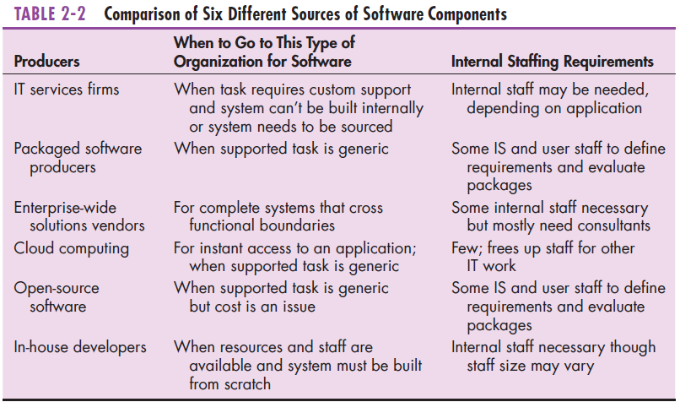
Sources of Software Components
Notes:
This gives a good overview of the types of problems and staffing requirements appropriate for each solution. Some are more appropriate for generic tasks and some for specialized. Cost has an impact on which to choose as well. And some require more internal resources than others.

Slide 23
Selecting Off-the-Shelf Software
Cost: comparing the cost of developing the same system in-house with the cost of purchasing or licensing the software package
Functionality: the tasks that the software can perform and the mandatory, essential, and desired system features
Notes:
These next few slides show factors to consider when selecting a software solution.

Slide 24
Selecting Off-the-Shelf Software (Cont.)
Vendor support: whether and how much support the vendor can provide and at what cost
Viability of vendor: can vendor continue to adapt/update software to changes in systems software and hardware

Slide 25
Selecting Off-the-Shelf Software (Cont.)
Flexibility: the ease with which software is customized
Documentation: understandable and up-to-date user’s manual and technical documentation

Slide 26
Selecting Off-the-Shelf Software (Cont.)
Response time: how long it takes the software package to respond to the user’s requests in an interactive session
Ease of installation: a measure of the difficulty of loading the software and making it operational

Slide 27
Validating Purchased Software Information
Send a request for proposal (RFP) to vendors.
  RFP – a document provided to vendors to ask them to propose hardware and system software that will meet the requirements of a new system
Use a variety of information sources:
  Collect information from vendor
  Software documentation
  Technical marketing literature
Notes:
If you are going to compare different vendors and service providers, you need a systematic way of doing this. A clearly stated RFP can help the vendor develop their proposals. You can use a variety of information sources to judge which solution is the best fit for your company’s needs.

Slide 28
Request For Proposal (RFP)
Sometimes called a Request For Quote (RFQ)
Analyst selects best candidates based on:
  vendor bids
  a variety of information sources

Slide 29
Information Sources For RFP
Vendor’s proposal
Running software through a series of tests
Feedback from other users of the vendor’s product
Independent software testing services
Customer surveys
Articles in trade publications are sometimes biased (seeded by manufacturer)
Notes:
Obviously, if you’re going to make wise purchasing decisions, you need to do some research. These are the types of information sources you’ll look at.

Slide 30
Reuse
The use of previously written software resources, especially objects and components, in new applications
Commonly applied to two different development technologies:
  Object-oriented development
  Component-based development

Slide 31
Reuse (Cont.)
Object-oriented development
  Object class encapsulates data and behavior of common organizational entities (e.g. employees)
Component-based development
  Components can be as small as objects or as large as pieces of software that handle single business functions
Notes:
Even if you do in-house development, you are reusing objects and components. For example, if you do Java programming, you are using the Java class library, which includes functionality for a wide variety of needs, including data structures, user interfaces, network and web processing, database manipulation, and a host of other services.

Slide 32
Reuse (Cont.)
Can be effective (increased productivity, less defects, reduced rework)
Technical issues – lack of methodology for component library (creating and labeling reusable components)
Organizational issues – lack of commitment, training, and organizational support; hard to measure economic benefits; legal and contractual issues

Slide 33
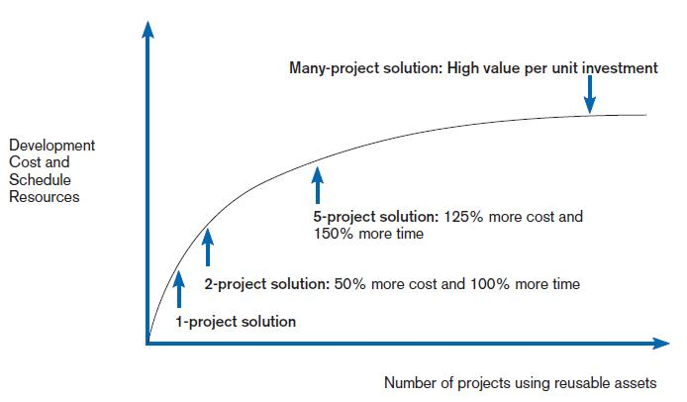
Costs and Benefits of Reuse
FIGURE 2-5
Investments necessary to achieve reusable components
(Source: Royce, Walker, Software Project Management: A Unified Framework, 1st ed.,
©1998. Reprinted and Electronically reproduced by permission of Pearson Education, Inc. Upper Saddle River, New Jersey.)
Notes:
The benefits of reuse grow as more corporate experience is gained from it, but so do the costs and the amount of resources necessary for reuse to work well.

Slide 34
3 Steps of Software Reuse
Abstraction – design of reusable piece of software
Storage – making software assets available for others
Recontextualization – making the software understandable to developers
(Grinter, 2001)
Notes:
The design could be from scratch, but very often it is based on reuse of other existing objects and components.
Storage isn’t as simple as it may seem. It requires correctly labeling and cataloguing assets so that others can find them.
Just because the software is easily accessible doesn’t mean people will use it. It needs to be easy to use and understand. That’s where recontextualization comes in. Part of that involves providing good documentation.

Slide 35
Approaches to Reuse
Ad-hoc: individuals are free to find or develop reusable assets on their own
Facilitated: developers are encouraged to practice reuse
Managed: the development, sharing, and adoption of reusable assets is mandated
Designed: assets mandated for reuse as they are being designed for specific applications
(Griss 2003)
Notes:
Recall the organizational and technical issues we talked about before. When choosing and approach to reuse, these issues will factor into the approach you choose. And the approach may evolve over time. For example, you wouldn’t use a mandated approach if there is a lot of resistance, and instead perhaps start with ad-hoc. Once it catches on, you can begin to encourage more, and only after time set up a formal framework.

Slide 36
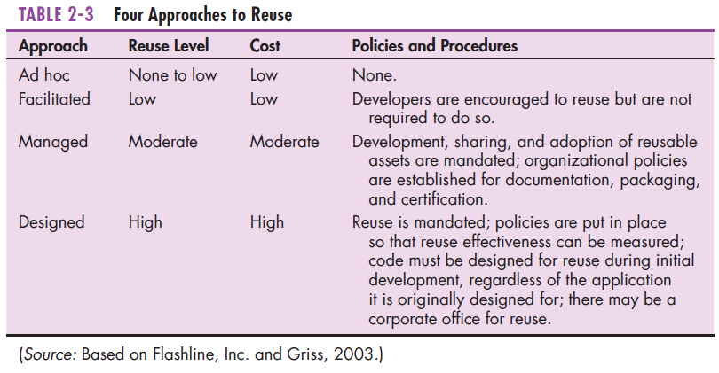
Approaches to Reuse (Cont.)
Notes:
Note the differences in terms of cost and in terms of policies and procedures. In terms of policies and procedures, you can go from completely ad hoc to something very formalized and measurable. As you get more formal and mandated about it, the level of reuse and its cost go up.

Slide 37
Summary
In this chapter you learned how to:
  Explain outsourcing.
  Describe six different sources of software.
  Discuss how to evaluate off-the-shelf software.
  Explain reuse and its role in software development.

